Slide 1

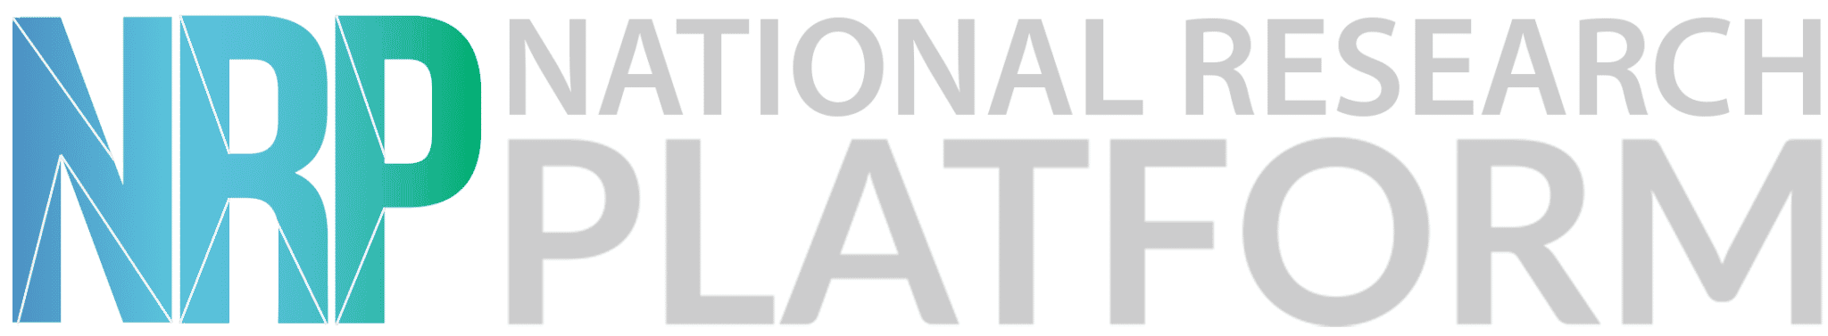
Welcome Everyone!
We’ll be starting at 10:05 AM PDT

Slide 2
The National Research Platform
Fall Training Series
Mohammad Firas Sada
University of California, San Diego
San Diego Supercomputer Center

Slide 3
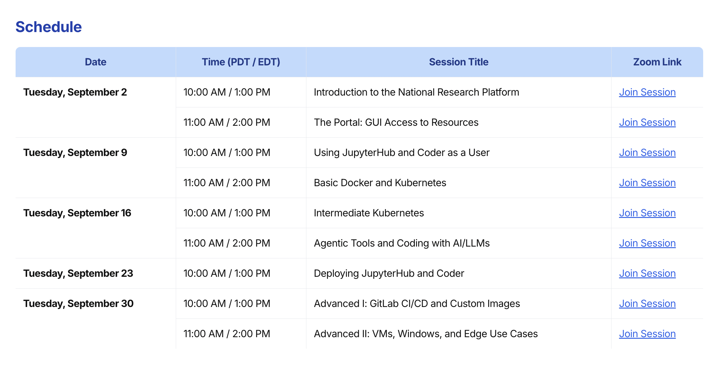
https://nrp.ai/training/

Slide 4
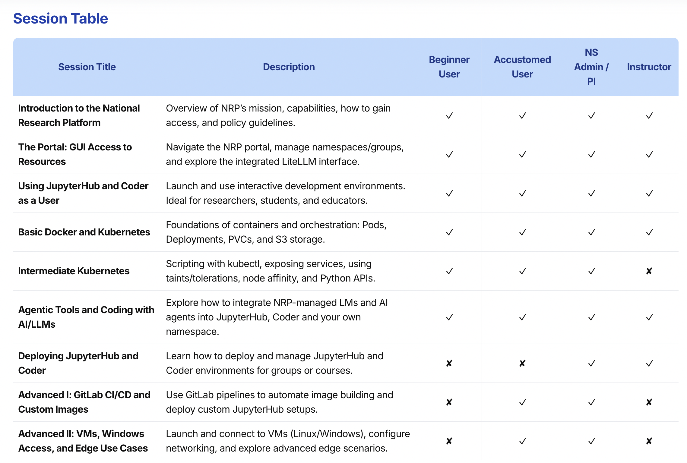
Today
Sep 23rd
Sep 30th

Slide 5
Important Notice
This training is intended as a supplement to the official NRP Documentation.
While the content presented here is accurate as of today, the official documentation is the primary and most up-to-date source of truth.
Please refer to https://nrp.ai/documentation/ for the latest information and updates.

Slide 6
Repository Link
https://github.com/nrp-nautilus/fall25training

Slide 7
This Session
Today’s Agenda:
Gaining access to Nautilus/NRP
Configuring kubectl (Kubernetes Control, the command-line tool used to interact with and manage Kubernetes clusters)
Docker
Nodes and Pods
GPU pods
Storage
Deployments: Scaling and Exposing
Batch Jobs
Debugging
Using Kubernetes Directly on Nautilus:
For beginners
For intermediate users
Using JupyterHub
Using Coder
Using Kubernetes
Previous Sessions

Slide 8
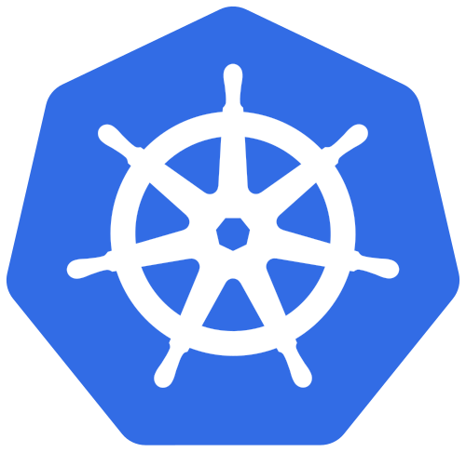
Using Kubernetes on Nautilus
National Research Platform Fall Training Series

Slide 9
Configuring kubectl
Link to extra training videos on configuring kubectl, kubelogin and k9s on Windows, macOS, Linux and console environments with no browser access:
https://nrp.ai/training/

Slide 10
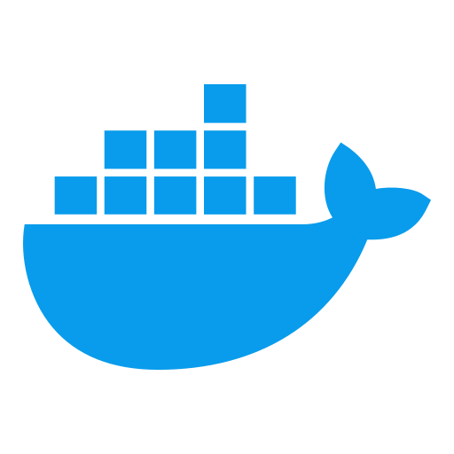
Docker
Docker is a platform for building, packaging, and running applications in containers.
Containers are lightweight, portable, and consistent environments.
They include everything your app needs: code, libraries, and dependencies.
Docker makes it easy to run the same app on your laptop, a server, or in the cloud.
Why Docker matters for Kubernetes:
Kubernetes doesn’t build containers, it runs them.
Docker (or other container runtimes) provides the container images that Kubernetes manages.
Pod → The smallest deployable unit in Kubernetes, which wraps one or more containers.

Slide 11
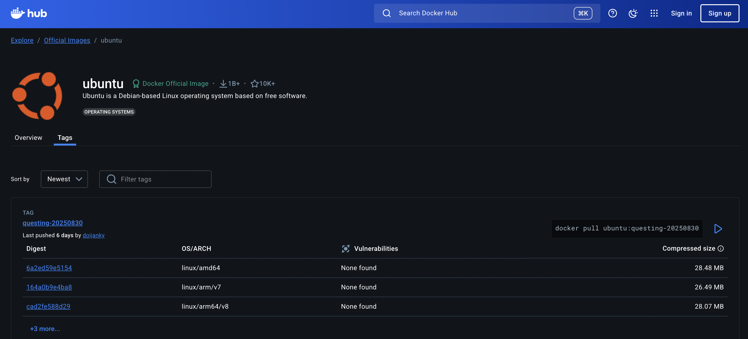
Docker
Docker Registry
A repository for storing and sharing Docker images.
Public example: Docker Hub (hub.docker.com)
Private registries are possible for internal use.
NRP’s GitLab: provides public/private registry based on repo’s settings. (If you have a local docker image, can push to gitlab, or build in gitlab)
Sep 30th
docker cli:
docker pull nginx:latest
Kubernetes YAML:
image: nginx:latest
Docker Hub

Slide 12
Nodes and Pods
Kubernetes Node
A machine (physical or virtual) that runs your containers.
Part of the Kubernetes cluster.
Runs Pods using the container runtime (e.g., Docker).
Pod
The smallest deployable unit in Kubernetes.
Can contain one or more containers.
Pods provide networking, storage, and lifecycle management for containers.
How they work together:
Nodes are the workers.
Pods run on nodes.
Kubernetes schedules Pods onto available nodes based on resources and policies.

Slide 13
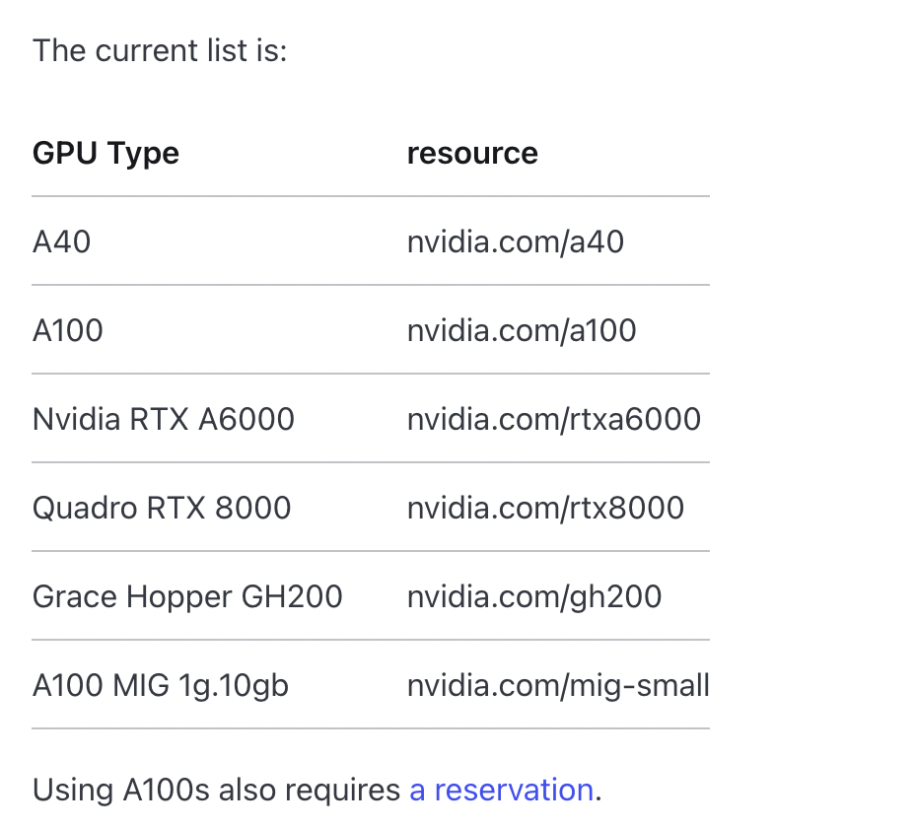
GPU pods
Define GPU Request in Pod YAML:
Specify the desired GPU count using the nvidia.com/gpu resource.
Example: nvidia.com/gpu: 1 requests one GPU.
Special GPUs are special resources.
Kubernetes Scheduling:
Kubernetes automatically schedules the Pod to a node with the requested GPU resources.
To select a specific GPU model from nvidia.com/gpu, target node labelling with nodeAffinity
Best Practices:
Always delete Pods when computation is complete to free GPU resources for others.
Avoid using sleep in Pods; instead, use batch jobs with actual scripts (no idling) to ensure efficient GPU utilization.

Slide 14
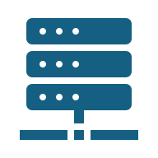
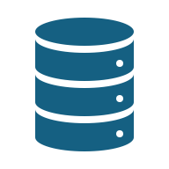

Storage
Persistent Volumes (PV) & Persistent Volume Claims (PVC)
PV: A storage resource in the cluster (like a disk or network storage).
PVC: A request for storage by a Pod; Kubernetes binds it to a matching PV.
Access Modes:
ReadWriteOnce (RWO): Mounted by a single node.
ReadWriteMany (RWX): Mounted by multiple nodes.
ReadOnlyMany (ROX): Read-only mounts by multiple nodes.
Ephemeral Storage
Temporary storage tied to the Pod lifecycle.
Data disappears when the Pod is deleted.
Useful for caching or scratch space.
Worker/Compute Node
Storage Node

Slide 15
Storage Types
CephFS (File system, RWX)
Good for workloads needing multiple nodes to read/write.
Main StorageClasses: rook-cephfs, rook-cephfs-central, rook-cephfs-east
Ceph RBD (Block storage, RWO)
Block storage per node, suitable for databases or single-node workloads.
Main StorageClasses: rook-ceph-block, rook-ceph-block-east, rook-ceph-block-central.
Linstor Block
Block storage with replication for reliability.
Not as large, use when fast IO is required.
S3 Compatible Storage: Object storage, accessed via S3 API
Sep 30th

Slide 16
Deployments: Scaling and Exposing
Deployments
A Deployment manages a set of Pods.
Handles rolling updates, self-healing, and replica management.
Scaling to a number of replicas (pods).
Deployments are purged after 2 weeks (w/ exceptions for persistent services).
Exposing Pods
Service: Stable network endpoint for Pods.
Each Pod gets its own IP assigned by Kubernetes.
Ingress: Route external traffic to Services using rules and hostnames.
Ingress cannot talk directly to Pods, it routes to a Service instead.
External client → Ingress → Service (ClusterIP) → Pods

Slide 17
Batch Jobs
Batch Job: A workload that runs a finite number of tasks to completion, unlike long-lived services.
Ideal for data processing, analysis, backups, periodic or on-demand tasks.
A Job manages Pods to ensure they run to completion, restarts it if it fails, up to a configurable backoffLimit.
Since jobs in Nautilus are not limited in runtime, you can only run jobs with meaningful command field. Running in manual mode (sleep infinity command and manual start of computation) is prohibited.

Slide 18
Debugging
Why Debug Pods? Pods may fail to start, crash, or behave unexpectedly.
Pods report their current state (Pending, Running, Completed, Error, etc.). In all states, pods are occupying resources.
Live Debugging / Exec: You can interact with a running Pod to inspect its environment.
Pod Logs: Containers write output to logs. Logs show what happened inside the Pod during execution.
Resource Awareness: Pods can fail due to CPU or memory limits.

Slide 19
Low Priority Workloads
Always consider the load of your workflow on the cluster
Priority Classes define the relative importance of pods in a cluster
Higher priority pods canpreempt (evict) lower priority pods when resources are scarce
Priority values can be positive (high priority) or negative (low priority)
Priority Values: opportunistic: -1,000,000,00
Not Allowed per policy
Recommended for heavy workflows

Slide 20
Service Accounts
Service Accounts provide identity for processes running in pods
They enable programmatic access to the Kubernetes API.
Don’t load kubeconfig files into pods, user Service Accounts.
Authentication vs Authorization
Authentication: "Who are you?" (Service Account + Token)
Authorization: "What can you do?" (RBAC - Roles & RoleBindings)

Slide 21
Exposing HTTP
Pods
Each pod gets its own internal IP
Pod IPs change when pods restart
ClusterIP Service
Gives a single, stable IP + name inside the cluster
Load balances across pods
Apps in the cluster use this to find each other
Ingress
Opens the door for HTTP/HTTPS traffic from outside
Uses the Service’s stable name/IP to reach pods
Can do host-based (app.com) and path-based (/api, /shop) routing

Slide 22
Python Kubernetes API Client
Accessing Kubernetes from Python
Why?
Automate tasks (create, delete, scale pods)
Build tools & scripts (CI/CD, monitoring, cleanup)
How?
Install the kubernetes Python package
Connect using kubeconfig (local) or service accounts (in-cluster)
What you get?
Control Pods, Services, Deployments, Jobs
Watch for changes & react in code

Slide 23
Selkies Desktop GUI
Why?
Access apps remotely (no installs)
Share GPU / resources
Same setup everywhere
How?
VNC / NoVNC: Remote desktops in browser
X11 forwarding: Faster native apps
GPU passthrough: Graphics + compute support
Selkies (browser desktops + Jupyter)
Use Cases
Remote dev workstations
Scientific visualization & data analysis
Training / shared lab environments
IDEs!

Slide 24
Selkies Desktop GUI
Why?
Access apps remotely (no installs)
Share GPU / resources
Same setup everywhere
How?
VNC / NoVNC: Remote desktops in browser
X11 forwarding: Faster native apps
GPU passthrough: Graphics + compute support
Selkies (browser desktops + Jupyter)
Use Cases
Remote dev workstations
Scientific visualization & data analysis
Training / shared lab environments
IDEs!

Slide 25

Q&A
National Research Platform Fall Training Series

